Slide 1

Many Companies
ONE PURPOSE

Slide 2

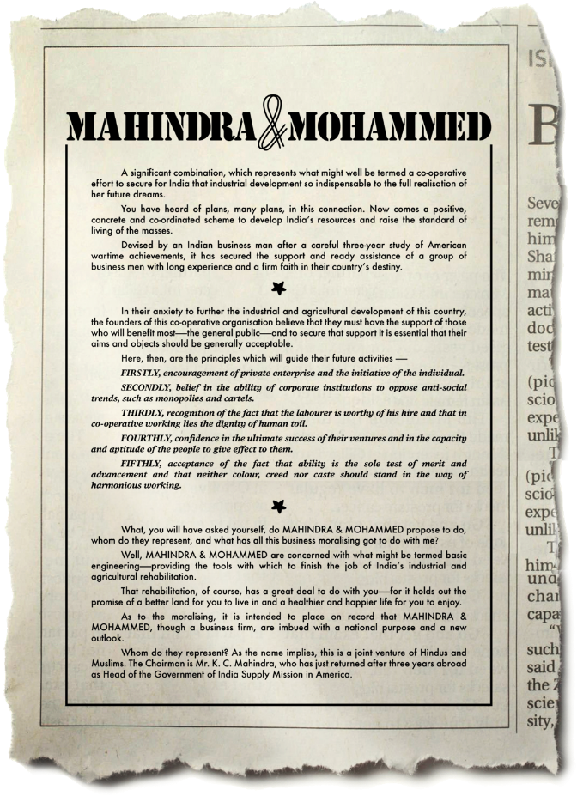


First Ad Released In 1945
DIGNITY
ENTREPRENEURSHIP
ETHICS
DIVERSITY
MERITOCRACY
Notes:
In the first ad Mahindra ever released, the founders spoke not of the products or services but about their guiding principles and values.

Slide 3
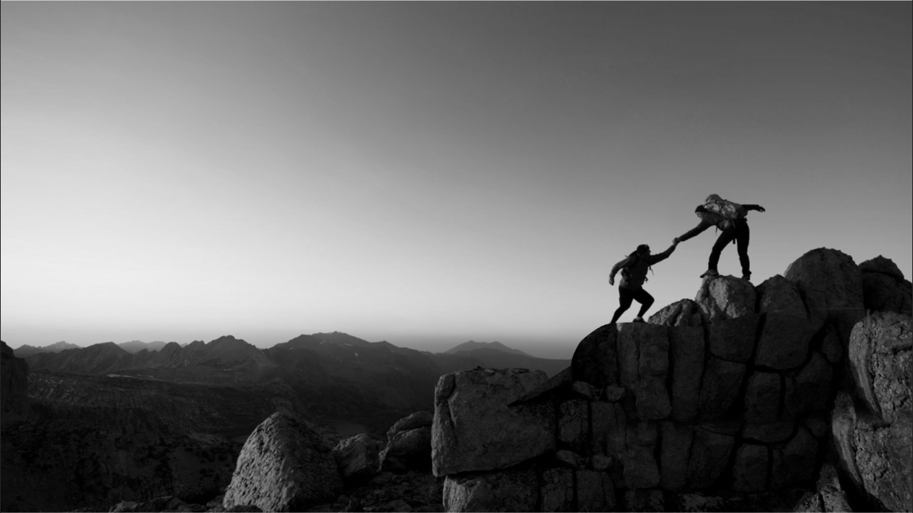
Our Purpose
Drive positive change in the lives of our communities.
Only when we enable others to rise will we rise.
#Together we rise
Notes:
Our purpose RISE has commercial logic and social logic.
At its essence it about shared value. What we do for our communities is interconnected with our success.
And hence it is about “Together We Rise”

Slide 4
PLAY FILM
Notes:
https://www.youtube.com/watch?v=8tSZgBpkT28

Slide 5
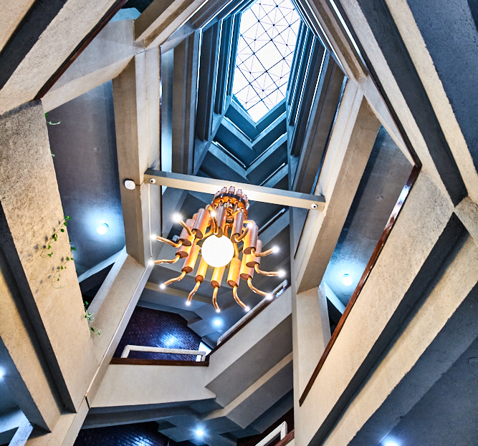




Overview
$19.7 B
TURNOVER
260,000+
EMPLOYEES
100+
COUNTRIES
20+
INDUSTRIES
Notes:
Our scale and strength

Slide 6











20+ Industries
AEROSPACE
DEFENCE
HOSPITALITY
PASSENGER &
COMMERCIAL
VEHICLES
TRACTORS
COMPONENT MANUFACTURING & STEEL SOLUTIONS
FARM EQUIPMENT
AGRI INDUSTRY
AUTO RECYCLING
AFTERMARKETS
LOGISTICS
RENEWABLE
ENERGY
LAST MILE MOBILITY
FINANCIAL SERVICES
VEHICLE & EQUIPMENT FINANCING
RURAL HOUSING FINANCE
MUTUAL FUNDS
INSURANCE BROKING
TECHNOLOGY
SERVICES
POWER SOLUTIONS
WATER UTILITY
CONSTRUCTION EQUIPMENT
REAL ESTATE
Notes:
We are present in 20+ industries

Slide 7















FOCUS
INDUSTRIES
4
8
4
  Core
  Businesses
  Growth
  Gems
  Digital
  Businesses
  Logistics
  Holidays
  Real Estate
  Susten
  Accelo
  Powerol
  Aerospace
  Classic Legends
  First Cry
  Car&Bike
  Digi Fin Co
  Porter
  Passenger
  Farm
  Finance
  Tech M
Notes:
16 focus industries of the Group

Slide 8

Group Market Capitalisation – F23 (10months)
INR 3,30,213 CR**
(US$ 40.31 BN^)
INR 39,790 CR*
(US$ 4.86 BN^)
*Price as on 31 March of corresponding fiscal year
**Price as on 31 January 2023
^US$ 1 = INR 81.92
INR 3,736 CR*
(US$ 0.46 BN^)
8
Notes:
Group market cap has seen a healthy 14% CAGR in last 16 years

Slide 9
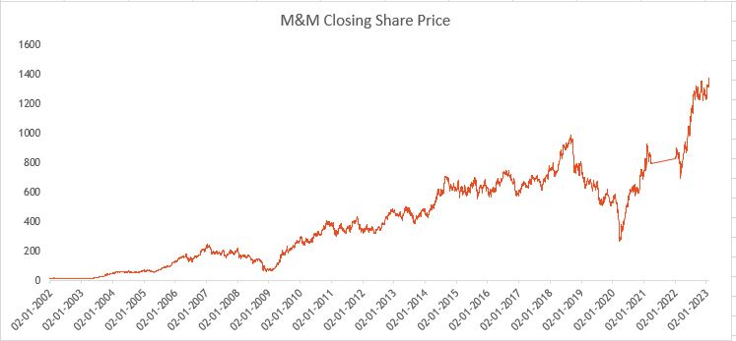
History of Value Creation
2002-2018
CAGR: 31%
04/20– 01/23
CAGR: 77%
08/18 – 03/20
CAGR: -54%
9
9
Notes:
We have been delivering consistent growth to our shareholders.
Almost 77% CAGR in the last 3 years

Slide 10








World's Largest Tractor Company by Volume
Among India’s
Top 5 IT Service Providers
India’s No. 1 SUV Manufacturer by market share
Amongst India’s
Largest Solar Companies
Shaping
India's No .1 Multi-Brand Certified Used-Car Company
Industries
No.1 Timeshare Company
outside of the USA
Transforming
Pioneer in Net Zero Buildings
in India
Lives
Among India's Largest Third-Party Logistics Service Providers
Only Indian OEM in Formula E
All-Electric Car Racing Championship
World's 1st All-Electric
Hyper car - Pininfarina Battista
Notes:
Occupying significant position in almost all businesses that we are in

Slide 11




GLOBAL FOOTPRINT
Operations in
100 countries
50+ manufacturing
Plants across the world
Leading tractor brands across the globe:
Mahindra, Swaraj,
Mitsubishi Mahindra,
Sampo Rosenlew, Erkunt
20 R&D Centres
across 9 countries
Tech M Leading digital transformation for Fortune 500 companies across 90 countries
Notes:
Strong global presence across the world both in services and manufacturing

Slide 12

Global Neural network
Centre of excellence for design, technology & engineering to deliver automobiles of the future
MEVTEC, Detroit
Mahindra Advance Design Europe (MADE), UK
Mahindra Research Valley (MRV), Chennai
Notes:
Our global neural network has key nodes at Detroit, UK and MRV Chennai.
These COEs for design, technology and engineering respectively work closely to deliver automobiles of the future

Slide 13
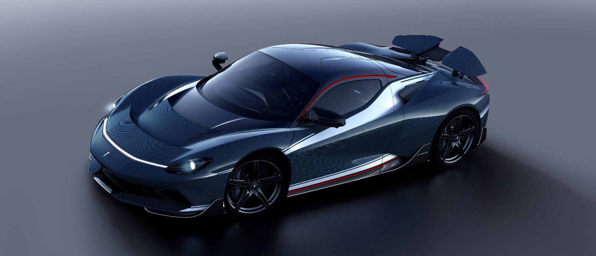
Battista Hyper GT –
World’s fastest street legal car
Mahindra’s Automobili Pininfarina
Notes:
World’s fastest street legal car is a Mahindra car

Slide 14
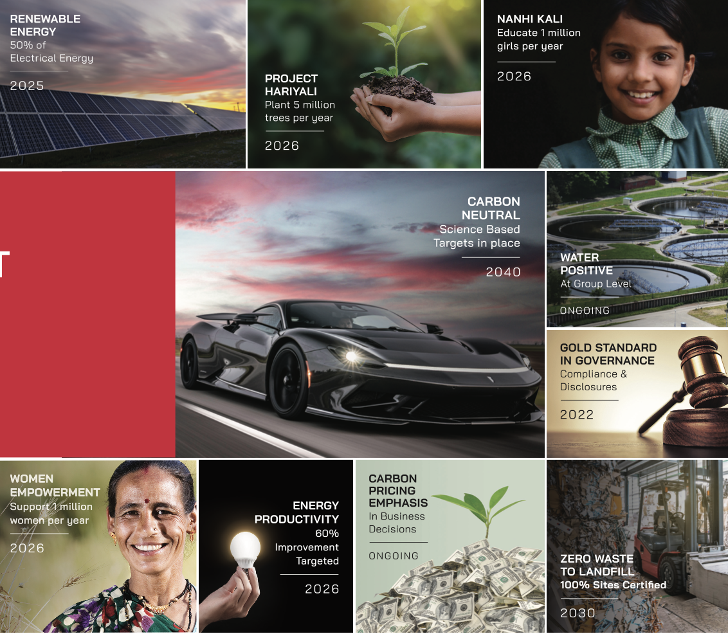
10 ESG Commitments
A Global Leader On ESG
Notes:
We are progressing as planned on ESG commitments.
On being carbon Neutral – We are 3 decades ahead of India, 1 decade ahead of Paris agreement
Our EP 100 program is focused on – doubling energy production
We are a Water positive company
We have a robust well governed social program - 50% donors for the Nanhi Kali program are external corporate

Slide 15
ESG IN ACTION…FEW EXAMPLES

Slide 16
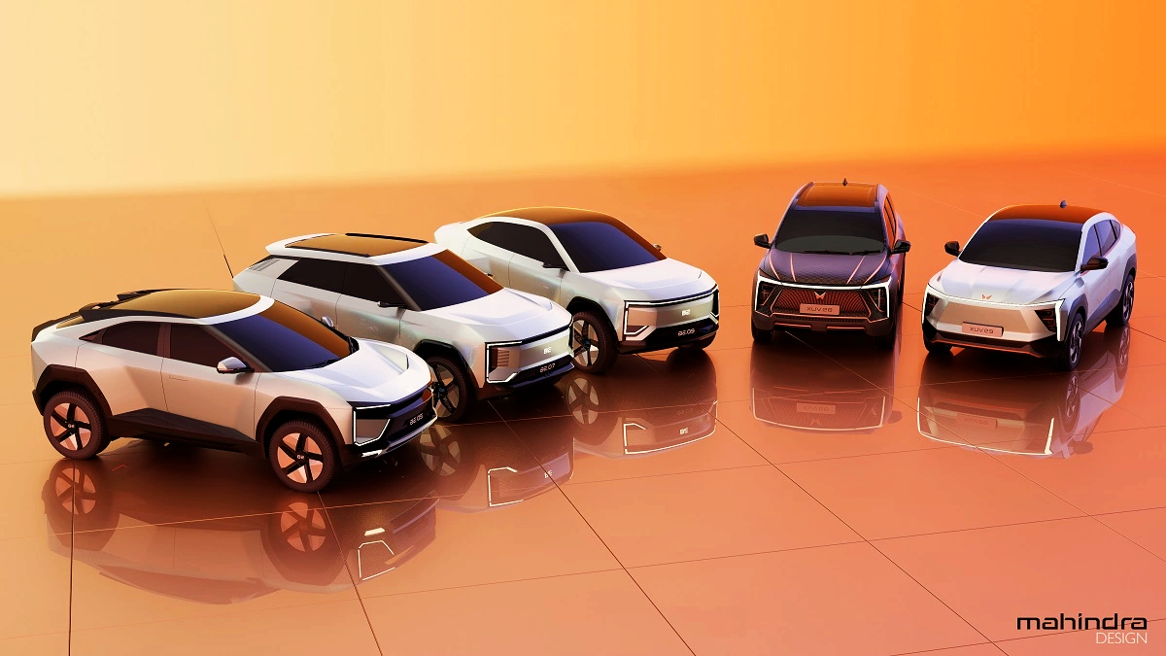
Born Electric Vision
Electric will be 25% of our PV portfolio by 2027
Notes:
Businesses committed to reduce carbon emissions by making green products

Slide 17
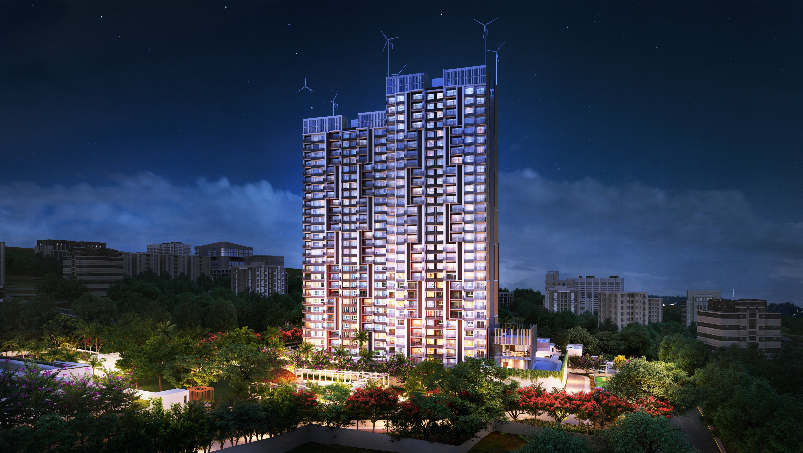
Mahindra Lifespaces
Project EDEN - first net zero energy building in India
All buildings Net Zero from the year 2030 onwards
Notes:
MLDL delivered first net zero energy building – EDEN
It has pledged to make all buildings Net Zero from the year 2030 onwards

Slide 18
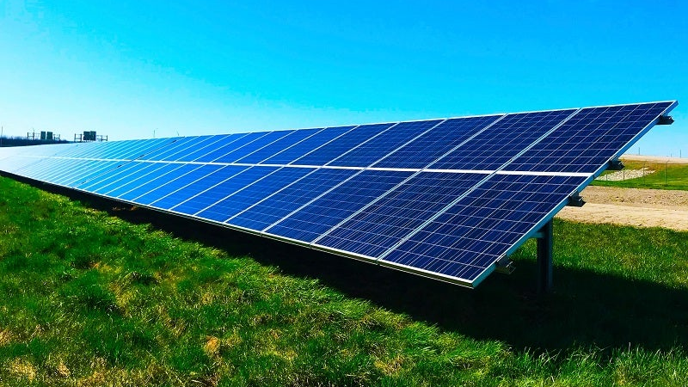
Mahindra Susten
Leading renewable energy IPP (Independent Power Producer) with portfolio of 1.55 GWp+
Notes:
Susten is a leading solar energy company in the country known for its technology, scale and performance

Slide 19

Mahindra Finance
1386
Branches
8.4 Mn
Customers
380000
Villages
More than the largest public sector bank in India
All numbers are as per end of Q2 FY’23
Notes:
Business improving lives at the grassroot level. Mahindra finance is financing small dreams of big India and has more reach than the largest public sector bank in the country

Slide 20
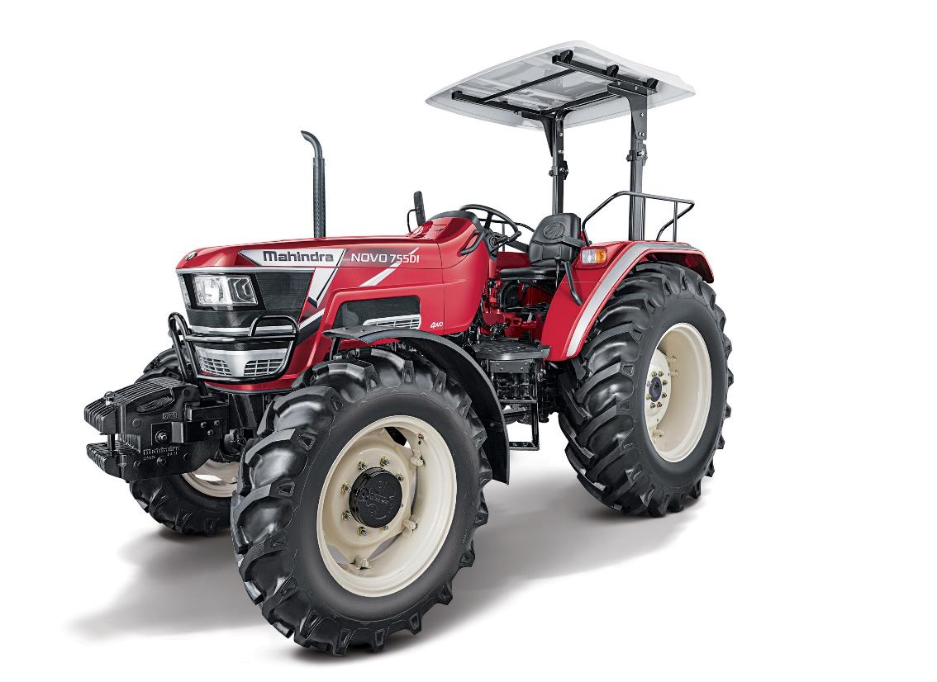
Mahindra Tractors
Tractors
Increased farm productivity for over 3 decades
Krish- e
Providing tech-enabled, affordable services & farming solutions to independent farmers
Prerna
Empowering women in agriculture through efficient and ergonomic farm tools and equipment
All numbers are as per end of Q2 FY’23
Notes:
Mahindra Tractors is empowering Indian farmers and helping them change their destiny through tech-enabled farm prosperity.

Slide 21





Recognition in ESG
First Indian ‘Automobile & Components’ company to enter the World Index of DJSI for the 2nd consecutive year
Tech Mahindra included in the DJSI World Index for the 8th consecutive year
Mahindra Lifespaces:
CDP: India’s only real estate company with A ranking in both Climate Change & Water Security
M&M: AAA rating
for 6 years in a row, from four key Credit Rating Agencies
Notes:
Our efforts in the area of ESG are being recognised globally

Slide 22
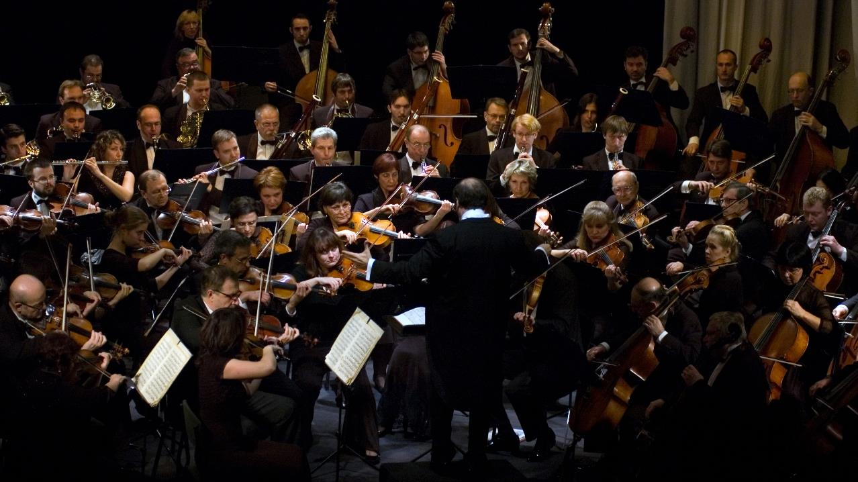
BE
COLLABORATIVE
22

Slide 23


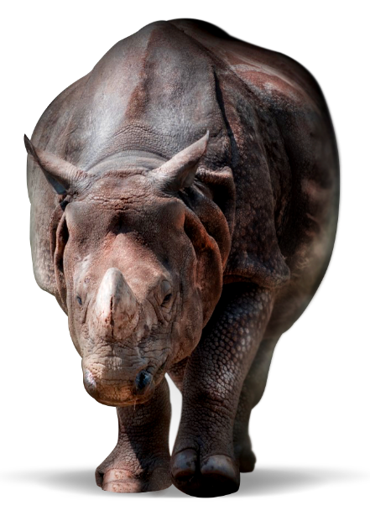


BE
AGILE
23

Slide 24
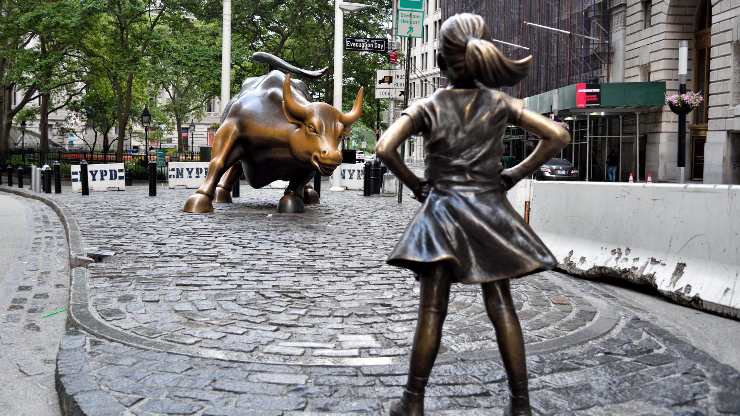
BE
BOLD
Editorial credit: Evan El-Amin / Shutterstock.com

Slide 25

Our legacy is the foundation for our future

Slide 26


